Slide 1
Housekeeping
Please keep your mic muted and video off
Please type any questions into the chat box, they will be answered at the end of the session.
If you joined by telephone: please send any questions from presenters to mnmonosky@mun.ca
The presentations will be recorded and uploaded to the AHIN website

Slide 2
Agenda
Presentations
Travis Hedwig, University of Alaska Anchorage
Jeannette Waegemakers Schiff, University of Calgary
Q&A period

Slide 3
At Home in the North Updates from Alaska
Travis Hedwig
Assistant Professor of Health Sciences
Division of Population Health Sciences
University of Alaska Anchorage

Slide 4
Acknowledgements
Dena'inaq ełnen'aq' gheshtnu ch'q'u yeshdu
I live and work on the land of the Dena’ina translation: S. Shaginoff-Stuart, J. Isaac
Interdisciplinary nature of applied health research
Increased recognition of how we think about our circumpolar connections

Slide 5
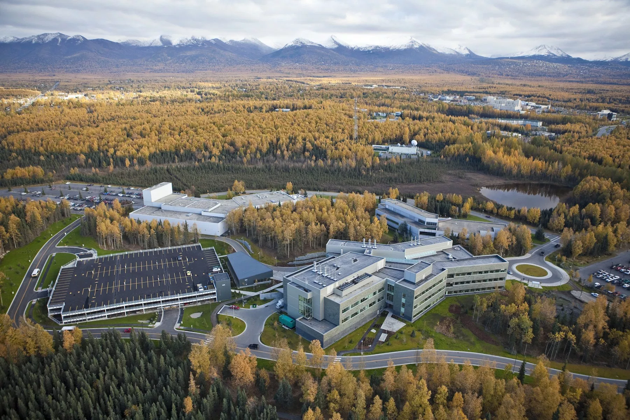
Alaska
Originally home to Indigenous cultures from 20 distinct regions
The descendants of these original cultures are collectively called “Alaska Natives”
Alaska Natives today belong to over 200 federally-recognized tribes
PHOTO: The University of Alaska Anchorage is built upon traditional Dena’ina Athabascan fishing and camping grounds.

Slide 6
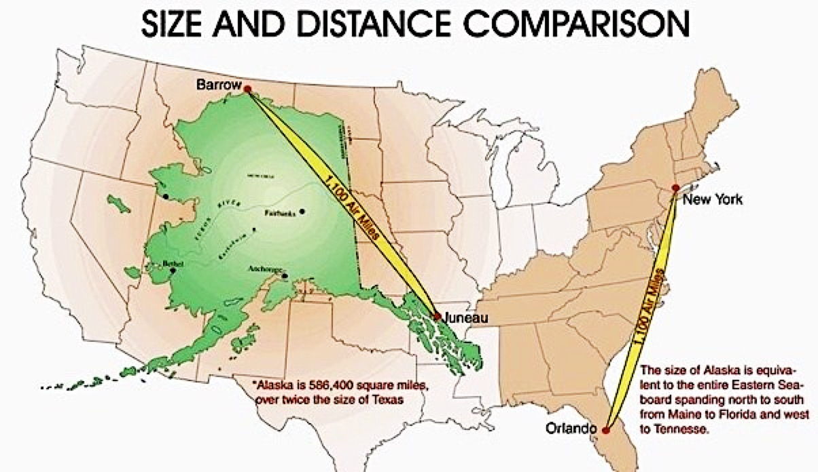
Largest state in USA
4th smallest population (~739,800 people)
Smallest per capita population
Only 26/352 communities have >1,000 people
Over half the population lives in the three largest cities:
Anchorage/Mat-Su (54%)
Fairbanks (13.5%)
Juneau (4.5%)
Urban Alaska total (72%)
Utqiagvik

Slide 7
Rural Alaska
92% of Alaska’s settlements are rural, with a population between 50-1,000 people
Some settlements are on the road system
Many are not
Rural settlements are often connected to larger “hub towns” within a region
Hubs have clinics, stores, government and Alaska Native offices, and some have college campuses
Spoke and wheel system
Bethel is a hub town of 6,370 people, providing services for 56 surrounding villages.

Slide 8
Data Sources
Alaska Coalition on Housing and Homelessness
https://www.alaskahousing-homeless.org/data
Alaska Department of Health and Social Services
Alaska Coronavirus Response Hub
https://coronavirus-response-alaska-dhss.hub.arcgis.com/

Slide 9
Houselessness in the throes of a global pandemic: Just a few problems
Dissonance with the messaging
“hunker down” where?
The “mask people”
Politicization of mask wearing/mandates
Mask warriors
Cultural solutions to?
All health and related systems of care under extreme pressure
Dwindling capacity, ICU shortage, hospital diversions
Shelters as “hotspots” for community transmission

Slide 10
Houselessness in the throes of a global pandemic: Some efforts underway
Extensive contact tracing efforts
Led by UAA, Division of Population Health Sciences
Contractual roles for Universities?
Series of “white papers” submitted to municipality of Anchorage
Housing, substance misuse, mental health, DV, congregate housing settings
Somewhat expanded emergency order?
Testing requirements for travel–honor system?
Mobile outreach
Combatting misinformation-–the biggest challenge of all?

Slide 11
Some questions for all of us
How can we translate knowledge to communities?
What needs to happen?
How can we learn from each other in our community of practice?
How has the coronavirus amplified existing vulnerabilities and what systems need to be in place to protect against this?
Thank you!!!
thhedwig@alaska.edu

Slide 12
Psychosocial Demands, Traumatic Stress and COVID responses Among Homeless Sector Workers
Jeannette Waegemakers Schiff PhD.
http://www.free-powerpoint-templates-design.com

Slide 13
Why look at staff psychosocial needs?
Reports of pervasive burnout among workers
Lack of recognition of work-related mental health
stresses. Traumatization may be an important dynamic
Concern over adequacy of staff training, supports, salaries and benefits, and reported high rates of
turn-over. Very costly for organizations
COVID exposure and precautions may be adding
significantly to this burden.

Slide 14
Prior Five Studies 2014 - 2019
Emergency shelters in Calgary
Emergency shelters in Edmonton
Domestic Violence Shelters – Calgary
Homeless housing and support services Saint John, NB
Housing and support programs serving homeless people - Calgary

Slide 15
Key questions
Are there high rates of burnout? Is traumatic stress greater prevalent?
Are staff adequately trained ?
Are organizational supports seen as adequate?
Given the pervasive effects of trauma in the lives of clients, does this impact staff through vicarious traumatization of direct traumatic stress?

Slide 16
What did we measure?
Burnout and professional quality of life (PROQoL)
Traumatic stress symptoms (PCL)
Life events (LEC)
Organizational and supervisory supports
Personal coping strategies
Life experiences and supports for Indigenous staff

Slide 17
Traumatic Stress and Vicarious Traumatization
33% - 41% of staff report rates of traumatic stress
33 – 41%
Why this difference
24% of staff report secondary traumatic stress (STS)
24%

Slide 18
Burnout and PTSD

Slide 19
COVID Crisis
Danger
Opportunity

Slide 20
Opportunities for Learning from COVID-19 Pandemic
Frontline workers are especially vulnerable
The have critical roles in assuring safety of extremely vulnerable people
They can not always work from home. Shelter staff always have direct contact
PPE (Personal Protective Equipment) and psychosocial supports may not be sufficiently available
Lack of flexibility in work conditions - frequency of in-person client interactions

Slide 21
Lessons Learned from COVID-19 Pandemic
Threats
Opportunities
Lack of recognition of vital role of frontline workers
increase training and
demand more relevant education
A
Provide multiple and diverse staff supports
Lack of training, and supervisory support
B
D
C
Implement Trauma-informed care at ALL levels of the organization
Lack of training in trauma-informed care

Slide 22
Next Steps
Survey staff to assess COVID-related stressors and supports
1
Interview senior managers to understand coping strategies that organizations have adopted
2
Understand which supports may have the greatest impact
3
Determine to what extent stress leave and disability leave are influenced by COVID stressors.
4

Slide 23
Thank you

Slide 24
Q&A Period
Presenters: please turn your video on
Attendees: Please keep your mic muted and video off unless you are asking a question
Questions will be answered in the order that they were asked in the chat
Use the “raise hand” button in the Participants panel to respond to a speaker

Slide 25
Webinar Discussion Questions
What are the biggest challenges you see in your community or region with regards to housing, shelter and support needs under the pandemic?
How are these needs currently being addressed? Where are the gaps?
How can we use this partnership to advocate for sustainable, long-term strategies to address northern housing need and related supports?

Slide 26
2nd AHIN COVID-19 and northern Housing call
Deadline for submission is Friday, December 4th
Two projects will be funded at $10,000 each (to be used during the 2020-2021 fiscal year). This funding is intended to support small-scale projects investigating partner-identified research questions broadly related to northern housing, homelessness supports and the COVID-19 pandemic
Contact Christina Goldhar at christina.goldhar@mun.ca to receive the proposal form if you haven’t already

